Slide 1



Slide 2



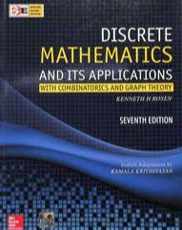
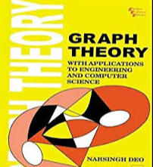
Recommended Textbook:
Narsingh Deo: Graph Theory with Applications to Engineering and Computer Science, PHI, 1974.
Rosen Kenneth: Discrete Mathematics and its Applications. McGraw Hill Publication- New Delhi.

Slide 3
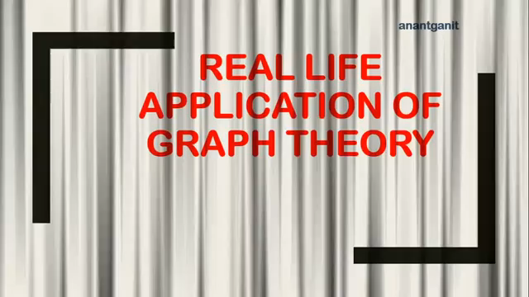

Slide 4
Application of Graph Theory
Computer Science – Graph theory is used for the study of algorithms. For example,
Kruskal's Algorithm
Prim's Algorithm
Dijkstra's Algorithm
Computer Network – The relationships among interconnected computers in the network follows the principles of graph theory.
Science – The molecular structure and chemical structure of a substance, the DNA structure of an organism, etc., are represented by graphs .
Electrical Engineering – The concepts of graph theory is used in designing circuit connections.
General – Routes between the cities, different places, can be represented using graphs

Slide 5
Graph Theory in CS
Programming
Data Structures
Automata Theory
Operating Systems
Compiler Design
Computer Network
Software Engineering

Slide 6
Graph Theory in ML
Bayesian Network
Social Network Analysis
Tree based approaches
Neural Network
Probabilistic Graphical Models
Domain Specific Problems: Fingerprint recognition, Face Recognition, etc.

Slide 7


Slide 8
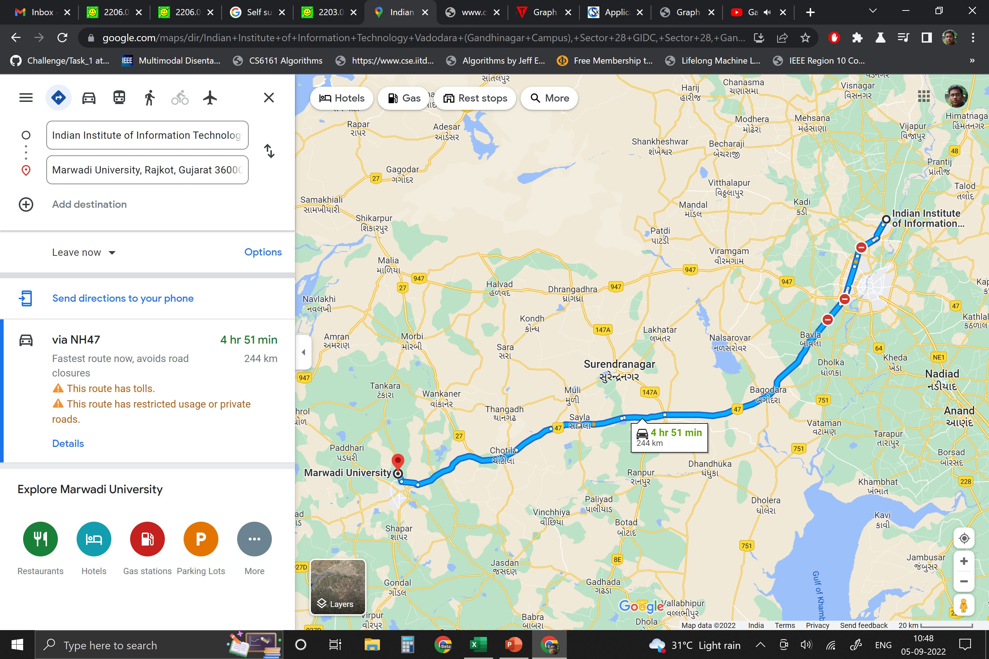

Slide 9
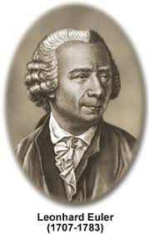
History
Leonhard Euler
the mathematician, astronomer, engineer (just a few of his titles),
who made significant contributions to calculus and the person who actually created graph theory that we depend on every single day..

Slide 10
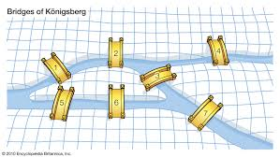
Seven Bridge Problem
Taking a walk through Konigsberg………
There were two large islands in the middle of the Pregel River, and they were each connected to one another, as well as to the two riverbanks on either side, which comprised the majority of the city. And how were they connected? By bridges, of course! Seven of them, in fact
The goal was to walk across all of the seven bridges crossing the islands only once, without ever repeating a single bridge in the course of one’s walk.

Slide 11
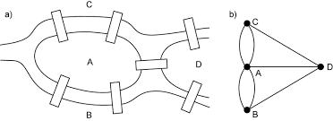
TITLE TEXT
Euler was hooked. Euler was so entranced, in fact, that he ended up writing a paper later that year that would contain a solution to the bridge problem.
But before we understand how Euler solved this problem, we need to cover a few basic graph theory rules first...

Slide 12
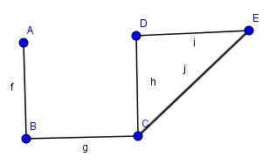
Definition -Graph
A graph is a pair of sets (V, E), where V is the set of vertices and E is the set of edges, connecting the pairs of vertices.
In this graph
V= {A,B,C,D,E}
E={AB,BC,CD,DE,CE}
= {f , g , h , I , j}

Slide 13
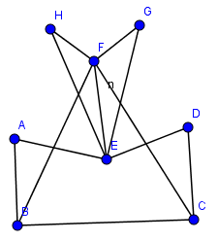
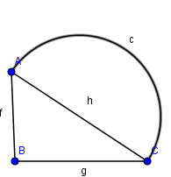
Examples

Slide 14
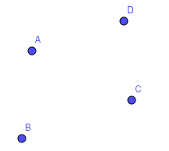
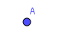
Important definition
Null graph :
A graph having no edges is called null graph
Trivial Graph:
A graph with only one vertex is called trivial graph .

Slide 15
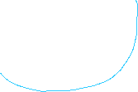
Loop
In a graph, if an edge is drawn from vertex to itself, it is called a loop.
Here A is a vertex for which it has an edge (A, A) forming a loop.
Parallel edges
In graph, if a pair of vertices is connected by more than one edge, then those edges are called parallel edges.
Here edges g and j are parallel edges.
A graph having parallel edges is known as a Multigraph .

Slide 16
Adjacent Vertices
In a graph, two vertices are said to be adjacent , if there is an edge between the two vertices. Here, the adjacency of vertices is maintained by the single edge that is connecting those two vertices.
Adjacent Edges
In a graph, two nonparallel edges are said to be adjacent, if there is a common vertex between the two edges. Here, the adjacency of edges is maintained by the single vertex that is connecting two edges

Slide 17
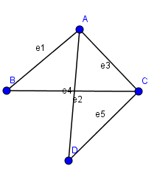
Here A and B are adjacent vertices, because there is edge e1 between A and B.
Similarly C and D are also adjacent because e5 is edge between C and D .
Vertices B and D are not adjacent vertices ..
Edges e1 and e3 are adjacent edges ,as there is a common vertex A between them.
Similarly for e3 & e5, e1 & e4...

Slide 18
Vocabulary
We can name individual vertices and edges
Edge e connects C and D vertices
C and D are ends points of e
C and e are incident
C and D are adjacent
C and D are neighbours

Slide 19
Degree of Vertex
Degree of vertex is the number of edges incident with the vertex V.
Notation: deg(V).
E
A
F
C
In this graph
deg(A)=2
deg(B)=2,deg(C)=2,deg(D)=0
deg(E)=4 ,deg(F)=0
B
D

Slide 20
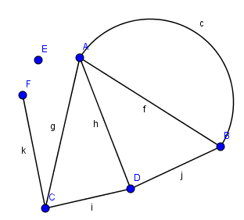
Pendent Vertex
A vertex with degree one is called a pendent
vertex.
here, deg(F) = 1
Isolated Vertex
A vertex with degree zero is called an isolated
vertex.
here, deg(E) =0

Slide 21
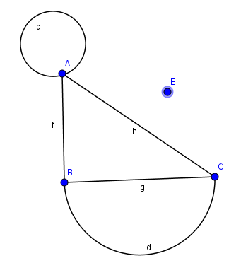
Exercise
Ex. 1 Find the degree of each vertices of following graphs.

Slide 22
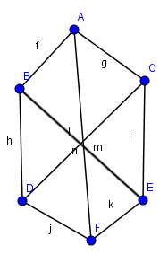
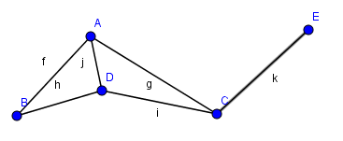
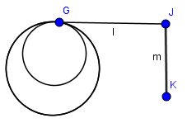

Slide 23
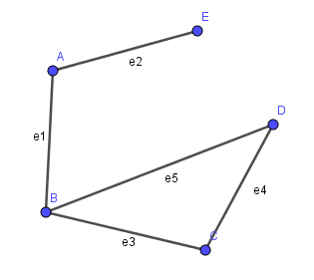
Ex .2 Draw a graph with five vertices {A,B,C,D,E} such that deg(A)=2, deg(B)=3, deg(C)=2, deg(D)=2, deg(E)=1

Slide 24
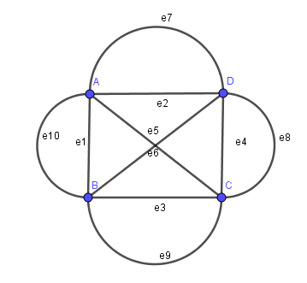
Ex .3 Draw a graph with 4 four vertices and all vertices have degree five

Slide 25
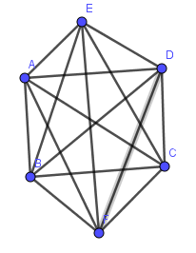
Ex .4 Draw a graph with six vertices such that degree of all vertices is five.

Slide 26
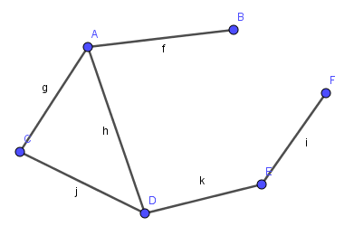
Ex .5 Draw a graph with six vertices A,B,C,D,E,F such that deg(A) =3 ,deg(B) =1 , deg(C)=2 , deg(D) = 3 and
E and F are adjacent .

Slide 27
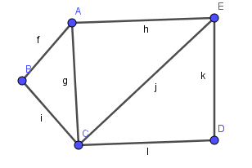
Ex. 6 Draw a connected graph with 5 vertices and 7 edges .

Slide 28
Ex. 7 A graph G has 15 edges, 3 vertices of degree 4 and other vertices of degree 3. Find the number of vertices in G.
Let n be the number of vertices in G.
The degree sum of all vertices of G = 2(15) = 30
Also, the degree of all vertices of G = 4(3) + 3(n-3)
30 = 12+3n-9
3n = 27
n = 9.

Slide 29

First theorem of Graph theory
Theorem 1 : In a graph G ,the sum of the degree of all the vertices of G is equal to twice the number of edges of G.
In other words : If G is a graph with n vertices and e edges then deg(V₁)+deg(V₂)+......deg(V_{n})=2*e ,where e is the total number of edges of G.
Proof:
Let f be any edge of graph G.
If f is a loop incident on vertex v₁ then f is counted twice when we count degree of vertex v₁.
If f is incident on v₁ and v₂ then f is counted in both; deg(V₁ ) and deg(V₂). So f is counted twice if we add deg(v₁) and deg(v₂ ).
So that adding the degree of all vertices involves counting twice of each edge of G .
Therefore, addition of degree of all vertices is equal to twice of number of edges.

Slide 30
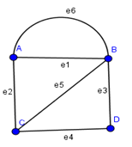
Example
deg(A)+deg(B)+deg(C)+deg(D)
=3+4+3+2
=12
=2 * 6
=2(number of edges)
Note that the sum of degree of all vertices in graph G is always even number

Slide 31

Theorem 2: The number of vertices of odd degree in a graph is always even
Proof
By the first theorem if G is a graph with n vertices and e edges then
$$\sum_{i=1}^{n}{deg(Vi)}=2∗e =even number ….(1)$$
The quantity in the left side of above equation can be expressed as the sum of even degree vertices and odd degree vertices as follow
$\sum_{i=1}^{n}{deg(Vi)}=\sum_{even}{deg(Vi)}+\sum_{odd}{deg(Vi)}$….(2)
Since the left hand side of the equation (2) is even by (1) and the first expression on the right hand side in (2) is also even as sum of even numbers is even. so second expression must be even

Slide 32
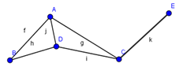
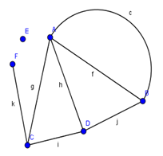

$\sum_{odd}{deg(Vi)}$ = even number
In above equation deg(V$i$) is odd so that the total number of the terms in the sum must be even to make a sum an even number.
Therefore the number of vertices of odd degree in a graph is always even.
Examples:

Slide 33
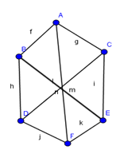
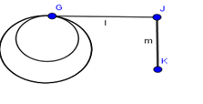
Simple Graph:
A graph G is called simple graph if G does not have any loop and parallel edges.
First graph below is a simple graph, and second is not a simple graph.

Slide 34
Regular graph :
If degree of all vertex of graph is same then it is called regular graph . If degree for every vertex is k, then graph is called k-regular graph.
Here, in this graph the degree for every vertex is 2 so this graph is regular graph and it can be written as 2- regular graph.

Slide 35
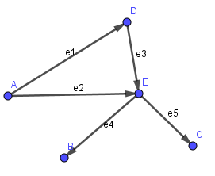
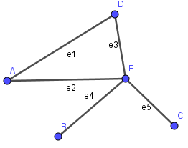
Directed Graph :
A graph is a directed graph ,where all edges are directed from one vertex to another vertex
Undirected graph : A graph is an undirected graph ,where all edges are bidirectional

Slide 36

Theorem 3: The maximum number of edges in a simple graph with n vertices is $\frac{n(n−1)}{2}$
Proof:
Let G is a simple Graph with n vertices.
Since G is a simple Graph first vertex can be adjacent with maximum (n – 1) vertices. So on first vertex n – 1 edges incident.
Now first vertex adjacent with second vertex so second vertex can be adjacent with maximum (n – 2) vertices. So on second vertex maximum (n – 2) new edges incident.

Slide 37

Continuing....
On (n-1)th vertex maximum 1 new edges incident.
So that the maximum number of edges in G
= (n-1) +(n-2) +(n-3) + ............+1 + 0
= (n-1) +(n-2) +(n-3) + ............+1 + n - n
= 1+ 2+3+……+ (n-3)+(n-2)+(n-1) +n - n
= $\frac{n(n+1)}{2}−n$
= $\frac{n(n−1)}{2}$

Slide 38
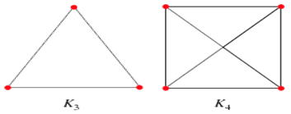
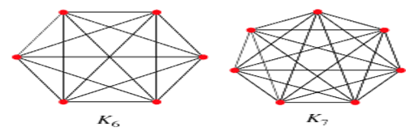
Complete graph
The simple graph is said to be complete graph if there exist an edge between each and every pair of vertices. A complete graph of n vertices is denoted by Kn.

Slide 39
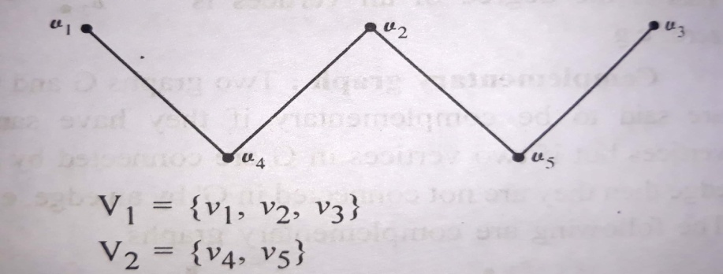
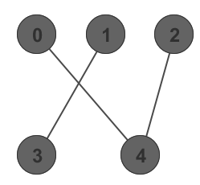

Bipartite graph:
A graph G(V,E) is called a bipartite graph if its vertex set V can be partitioned into two nonempty subsets V$1$ and V$2$ such that each edge of G has one end point in V$1$ and the other end point in V$2$. The partition V = V$1$UV$2$ is called bipartition of G.

Slide 40
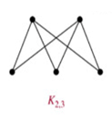
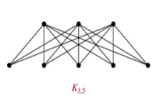
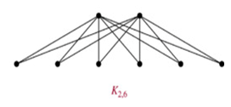

Complete bipartite graph
A bipartite graph ‘G’, G = (V, E) with partition V = {V1, V2} is said to be a complete bipartite graph if every vertex in V1 is connected to every vertex of V2 by an edge.
If |V1| = m and |V2| = n, then the complete bipartite graph it is denoted by $K_{m,n}$

Slide 41
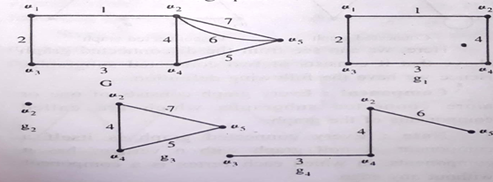

Sub graph
A graph $H=\left.(\right.V_{1},E_{1})$is called sub graph of graph G = (V, E) if is subset of V and is subset of E
$${ V}_{1}$$
$$E_{1}$$

Slide 42
Examples
1) Find the number of edges in graph G, if it has 5 vertices each of degree 4.
ANS: Let e be the number of edges in G.
By the first theorem
deg(V1)+deg(V2)+deg(V3)+deg(V4)+deg(V5)= 2e
4+4+4+4+4= 2e
20=2e
e = 10.
2) Find the number of edges in graph G, if it has 3 vertices of degree 3, 2 vertices of degree 2 and 1 vertex of degree 5.
ANS: Let e be the number of edges in G.
By the first theorem
3deg(Vi)+2deg(Vj)+deg(Vk)= 2e
3(3)+2(2)+5= 2e
18=2e
e = 9.

Slide 43
Que. Find the number of edges in graph $K_{6}$ and $K_{2,3}$
Que. Draw $K_{4}$ , $K_{7}$ , $K_{3, 5 } and$ $K_{6, 4 }$

Slide 44
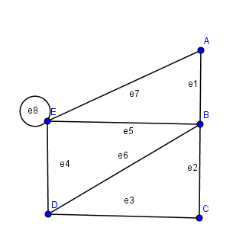
Definition- Walk
A Walk is defined as a finite alternating sequence of vertices and edges beginning and ending with vertex
No edge appears more than once in walk.
A vertex ,however ,may appear more than once .
The length of the walk is the number of edges in it .
A walk is closed if the first vertex and last vertex are same .
in this graph .
(1) A e1 B e2 C e3 D e4 E
(2) E e8 E e4 D e6 B e1 A are Walk
but
(3) A e1 B e5 E e8 E e7 A e1 B e2 C
is not a walk.
(Because edge e1 is repeated)
Here Closed walk is A e1 B e2 C e3 D e4 E e7 A

Slide 45
Definition - Path
An Open walk in which no vertex appears more than
once is called Path .
The number of edges in path is called length of path
We can include self loop in walk but not in path .
In the figure
(1) A e1 B e2 C e3 D e4 E is a path
But
(2) E e8 E e4 D e6 B e1 A (3)A e1 B e2 C e3 D e6 B are not path .

Slide 46
Definition - Circuit
A Closed walk in which no vertex ( except initial and final vertex ) appears more than once is called circuit .
here
(1) A e1 B e5 E e7 A
(2) B e6 D e4 E e5 B are
circuits.
A circuit is also called a cycle
Clearly , every vertex in a circuit is of degree two.

Slide 47
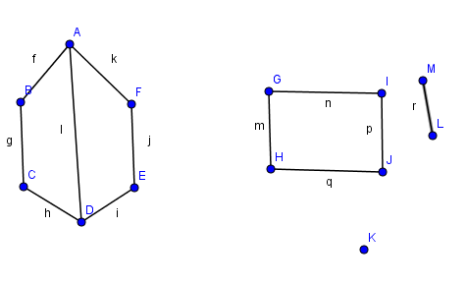
Connected Graph & Disconnected Graph
A Graph G is said to be connected if there is at least one path between every pair of vertices in G . Other wise it is disconnected

Slide 48
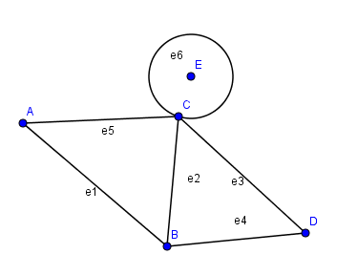
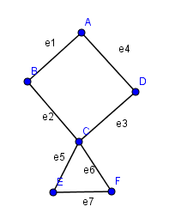
Exercise:
Evaluate the at least 5 walks (closed and open ), paths and circuits for the following graphs.

Slide 49
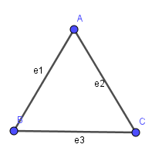
Euler Graph
In a graph G if it is possible to find a closed walk running through every edge of G exactly once , then such walk is called Euler line .
A graph that consists of Euler line is called an Euler Graph .
This graph is Euler graph because we get Euler line as A e1 B e3 C e2 A

Slide 50
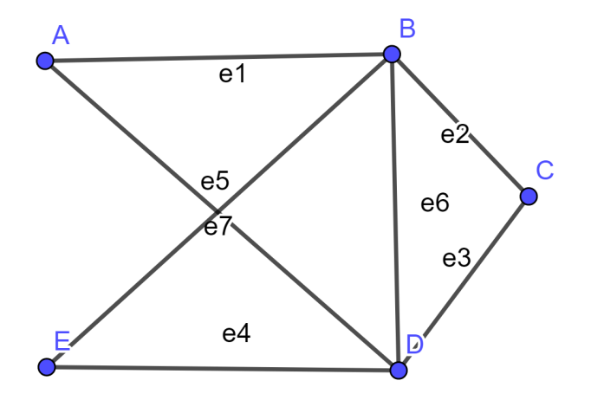
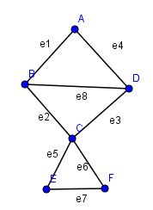
Here
Closed walk is A e1 B e2 C e3 D e4 E e5 B e6 D e7 A is Euler line so this graph is Euler graph .
In this graph:
A e1 B e2 C e5 E e7 F e6 C e3 D e4 A is closed walk but not Euler line because edge e8 we cant include. so it not Euler graph .

Slide 51
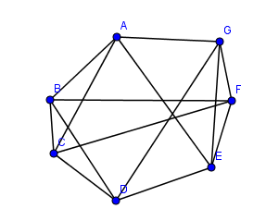
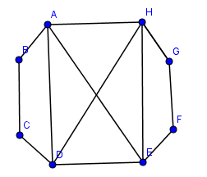
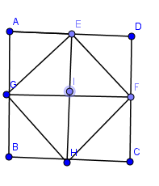
Determine which of the following graph is
Euler graph and write Euler line.
Give the reason if it is not Euler graph
A given connected graph G is an Euler graph iff all Vertices of G are of Even degree .

Slide 52
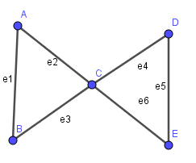

Hamiltonian Graph
A circuit in a connected graph G is said to be Hamiltonian
circuit if it includes every vertex of G.
A graph which has Hamiltonian circuit is known as Hamiltonian Graph
In following graph the circuit
A e1 B e2 C e3 D e5 E e7 A is
Hamiltonian circuit so
it is Hamiltonian graph .
This graph is not Hamiltonian because there is no Hamiltonian circuit .
A e1 B e3 C e4 D e5 E e6 C e2 A
Vertex C will be repeated in circuit to include all vertices.

Slide 53

Hamiltonian Path
If we remove any edge from a Hamiltonian circuit, then it called a Hamiltonian path.
The length of Hamiltonian path
(if it exists) in a connected graph
of n vertices is n-1 .
It is easy to construct a Hamiltonian
circuit in Complete graph .
we can get easily a Hamiltonian
circuit A e1 B e2 C e3 D e4 E e5 A

Slide 54

Petersen Graph
This graph is know as Petersen graph .it has not Hamiltonian circuit so it is not Hamiltonian graph .

Slide 55


TITLE TEXT
Determine which of the following graph is
Hamiltonian graph and write Hamiltonian circuit.
Give the reason if it is not Hamiltonian graph

Slide 56


Tree
A tree is connected graph without any circuits.
In other words a connected graph with no cycles.
The edges of the tree are known as branches and vertices of the trees are known as nodes
Tree is a simple graph.
i.e having neither a self loop nor parallel edges.
For tree we should have at least one vertex.
A vertex of degree one in a tree is called a leaf.
A tree with one ,two ,three ,four vertices

Slide 57

Forest
A disjoint collection of trees is known as forest .
The following graph is a forest

Slide 58


TITLE TEXT
Theorem : There is one and only one path between every pair of vertices in a tree T .
Proof:
Since T is connected graph ,there must exist at least one path between
every pair of vertices in T ,
Now suppose that between two vertices A and C of T there are
two distinct paths .
Path 1 : A e1 B e3 C
Path 2 : A e4 C
The union of these paths will contain a circuit and T can not be Tree.
U : A e1 B e3 C e4 A

Slide 59


Theorem : A tree with n vertices has n-1 edges .
Proof:
By the induction rule
It is easy to see that the theorem is true for n =1 , 2 and 3 .
Assume that the theorem holds for all tree with n-1 vertices.
( i.e. A tree with n-1 vertices has n-2 edges )
Let G be tree with n vertices.

Slide 60

Pick up any leaf v and let e ={v,w} be an edge .
Now remove v and e form the graph G and get graph H
Now consider the graph H :
it is connected graph ,
it has no circuits (cycles)
So H is tree with n-1 vertices .
and it has n-2 edges (Because of Assumption)
Therefore G has (n-2)+ 1 = n-1 edges .
Hence it is proved

Slide 61

Binary Tree
A binary tree is defined as a tree in which there is exactly one vertex of degree two ,and each of the remaining vertices are of degree one or three.
Since the vertex of degree two is distinct from all other vertices. This vertex is called a root . Here Vertex A is root.

Slide 62
Properties
The number of vertices in a binary tree is always odd.
because there is exactly one vertex of even degree, and the
remaining n-1 vertices are of odd degree .
Let p be the number of pendant vertices in a binary tree T. then
n – p - 1 is the number of vertices of degree three.
In example [ n = 13 , p = 7 then n - p -1 = 5]
A non pendant vertex in a tree is called an internal vertex.

Slide 63


Spanning Tree
A tree T is said to be spanning tree of a connected graph G if T is a sub graph of G and T contains all vertices of G
It is noted that spanning tree is defined only for a connected graph because a tree is always connected graph,
We can not get spanning tree for disconnected graph

Slide 64
Circuit Rank
Let G be a connected graph with ‘n’ vertices and ‘m’ edges.
Therefore, the number of edges you need to delete from ‘G’ in order to get a spanning tree = m-n+1
This is known as Circuit Rank of Graph G.
In the Above examples
n = 7 , m =9 Circuit rank =9 – 7 + 1 = 3

Slide 65
Example
Let ‘G’ be a connected graph with six vertices and the degree of each vertex is three. Find the circuit rank of ‘G’.
Solution : As we know that number of edges = degree sum / 2 by the first theorem of graph theory.
Here, degree sum = 6 × 3 = 18
So, |E| = 18/2 = 9
hence, Circuit rank =m-(n-1)
= |E| – (|V| – 1)
= 9 – (6 – 1) = 4

Slide 66

Spanning tree of a graph is just a subgraph that contains all the vertices and is a tree.
A graph may have many spanning trees.

Slide 67
All 16 of its Spanning Trees
Complete Graph

Slide 68


Minimum (weighted) Spanning tree:
A tree T is said to be A minimum weighted spanning tree of a graph G if T is a sub graph of connected graph G which connects all vertices together ,without any cycles and minimum possible total edge weight.
In other words, T is known as minimum spanning tree if it is a spanning tree whose sum of edge weights is as small as possible.

Slide 69
Minimum (weighted) Spanning tree:
The Minimum Spanning Tree for a given graph is the Spanning Tree of minimum cost for that graph.
Complete Graph
Minimum Spanning Tree
7
2
2
5
3
3
4
1
1

Slide 70

Minimum Spanning Tree (Using Kruskal Algorithm)
B
4
C
4
2
1
A
4
E
1
F
D
2
3
10
G
5
6
3
4
I
3
J

Slide 71
A
4
B
A
1
D
B
4
C
B
4
D
B
4
C
B
10
J
C
2
E
4
2
1
C
1
F
D
6
J
A
4
E
1
F
2
E
2
G
F
3
G
D
3
10
G
5
F
5
I
G
3
I
6
3
4
I
I
3
J
G
4
J
3
J

Slide 72
Sort Edges
(in reality they are placed in a priority queue - not sorted - but sorting them makes the algorithm easier to visualize)
A
1
D
C
1
F
C
2
E
E
2
G
B
4
C
F
3
G
G
3
I
4
2
1
I
3
J
4
A
4
A
B
E
F
1
2
B
4
D
B
4
C
D
3
10
G
5
G
4
J
F
5
I
6
3
4
I
D
6
J
B
10
J
3
J

Slide 73
Add Edge
1
1
A
D
C
F
C
2
E
E
2
G
B
4
C
F
3
G
G
3
I
4
2
1
I
3
J
4
A
4
A
B
E
F
1
2
B
4
D
B
4
C
D
3
10
G
5
G
4
J
F
5
I
6
3
4
I
D
6
J
B
10
J
3
J

Slide 74
Add Edge
1
1
A
D
C
F
C
2
E
E
2
G
B
4
C
F
3
G
G
3
I
4
2
1
I
3
J
4
A
4
A
B
E
F
1
2
B
4
D
B
4
C
D
3
10
G
5
G
4
J
F
5
I
6
3
4
I
D
6
J
B
10
J
3
J

Slide 75
Add Edge
1
1
A
D
C
F
C
2
E
E
2
G
B
4
C
F
3
G
G
3
I
4
2
1
I
3
J
4
A
4
A
B
E
F
1
2
B
4
D
B
4
C
D
3
10
G
5
G
4
J
F
5
I
6
3
4
I
D
6
J
B
10
J
3
J

Slide 76
Cycle
Don’t Add Edge
1
1
A
D
C
F
C
2
E
E
2
G
B
4
C
F
3
G
G
3
I
4
2
1
I
3
J
4
A
4
A
B
E
F
1
2
B
4
D
B
4
C
D
3
10
G
5
G
4
J
F
5
I
6
3
4
I
D
6
J
B
10
J
3
J

Slide 77
Add Edge
1
1
A
D
C
F
C
2
E
E
2
G
B
4
C
F
3
G
G
3
I
4
2
1
I
3
J
4
A
4
A
B
E
F
1
2
B
4
D
B
4
C
D
3
10
G
5
G
4
J
F
5
I
6
3
4
I
D
6
J
B
10
J
3
J

Slide 78
Add Edge
1
1
A
D
C
F
C
2
E
E
2
G
B
4
C
F
3
G
G
3
I
4
2
1
I
3
J
4
A
4
A
B
E
F
1
2
B
4
D
B
4
C
D
3
10
G
5
G
4
J
F
5
I
6
3
4
I
D
6
J
B
10
J
3
J

Slide 79
Add Edge
1
1
A
D
C
F
C
2
E
E
2
G
B
4
C
F
3
G
G
3
I
4
2
1
I
3
J
4
A
4
A
B
E
F
1
2
B
4
D
B
4
C
D
3
10
G
5
G
4
J
F
5
I
6
3
4
I
D
6
J
B
10
J
3
J

Slide 80
Cycle
Don’t Add Edge
1
1
A
D
C
F
C
2
E
E
2
G
B
4
C
F
3
G
G
3
I
4
2
1
I
3
J
4
A
4
A
B
E
F
1
2
B
4
D
B
4
C
D
3
10
G
5
G
4
J
F
5
I
6
3
4
I
D
6
J
B
10
J
3
J

Slide 81
Add Edge
1
1
A
D
C
F
C
2
E
E
2
G
B
4
C
F
3
G
G
3
I
4
2
1
I
3
J
4
A
4
A
B
E
F
1
2
B
4
D
B
4
C
D
3
10
G
5
G
4
J
F
5
I
6
3
4
I
D
6
J
B
10
J
3
J

Slide 82
Minimum Spanning Tree
B
4
C
4
B
C
4
4
2
1
2
1
A
E
A
4
1
F
E
F
1
D
2
2
D
3
10
G
G
5
3
6
3
4
I
I
3
3
J
J

Slide 83


FIND MINIMAL SPANNING TREE

Slide 84
END OF UNIT-4

